Slide 1

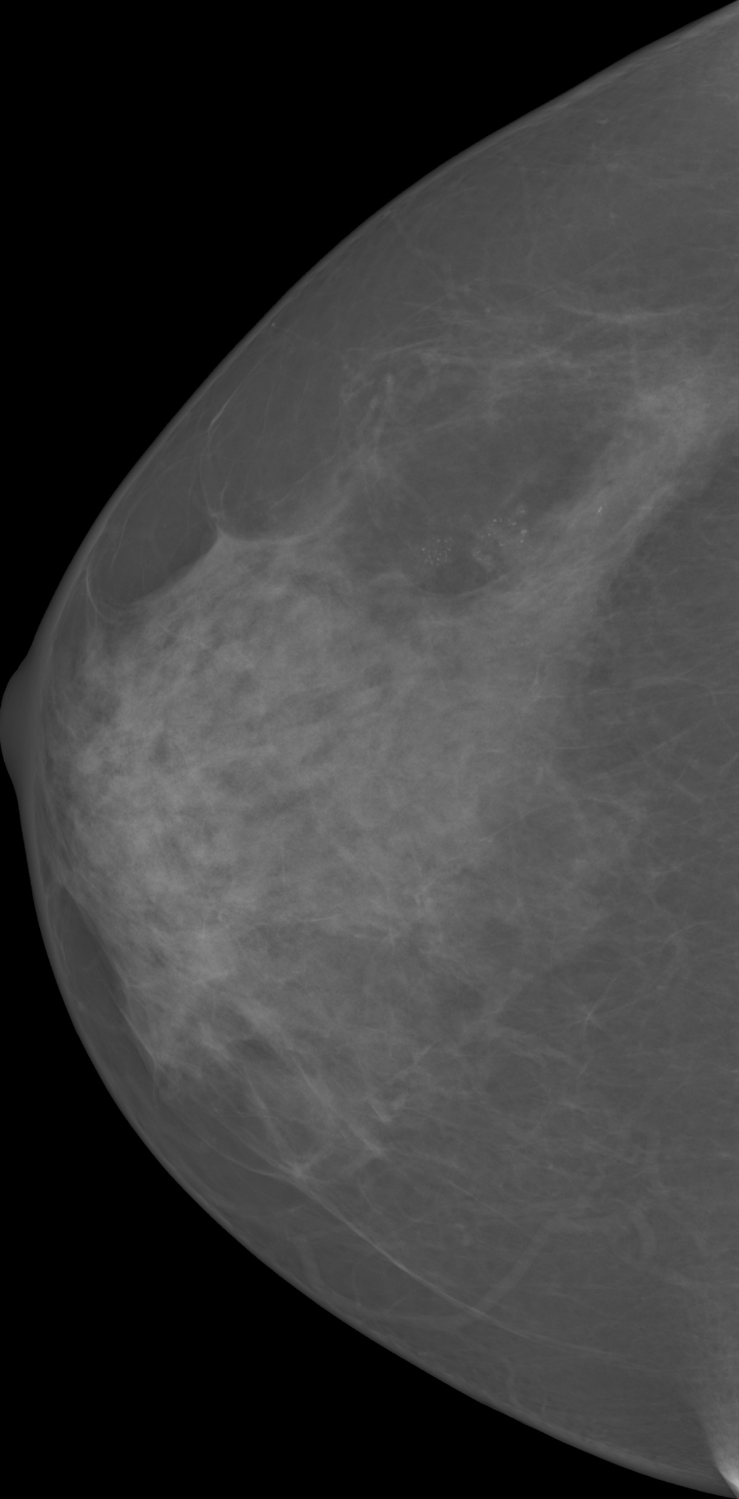
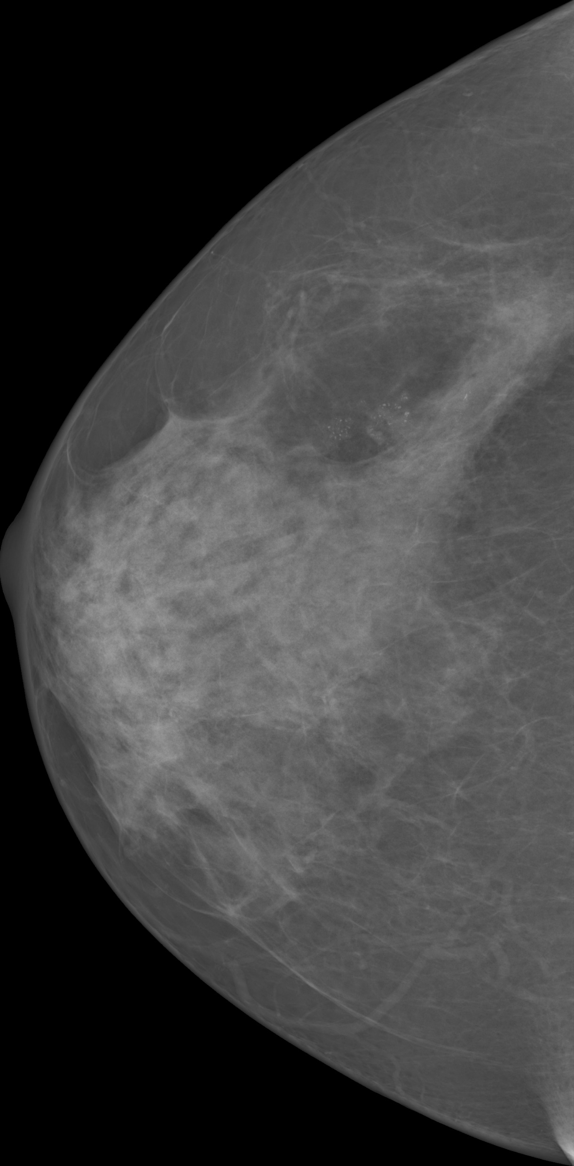
(a)
(b)
(c)
(d)
(e)
Pre-processing

Slide 2
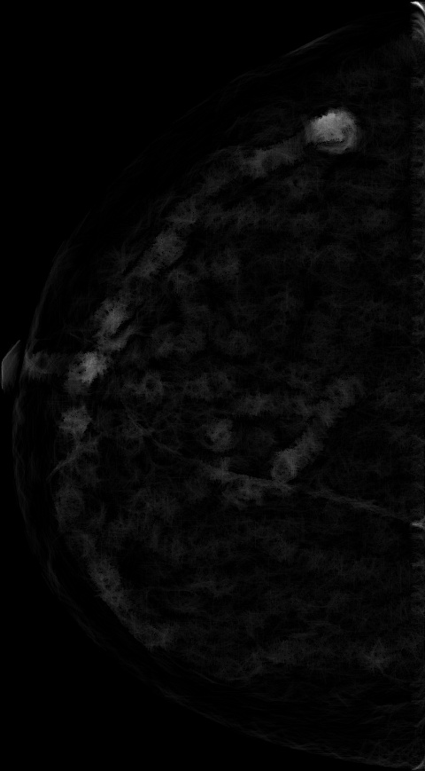
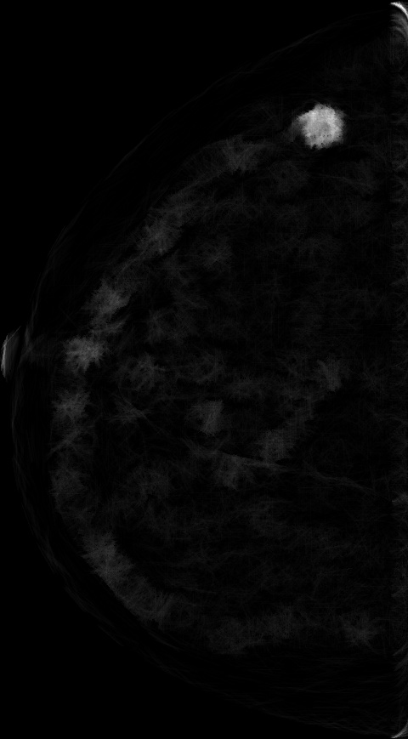

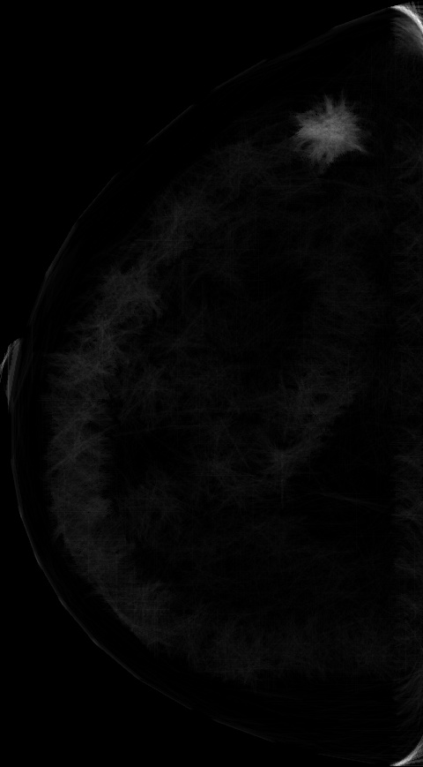
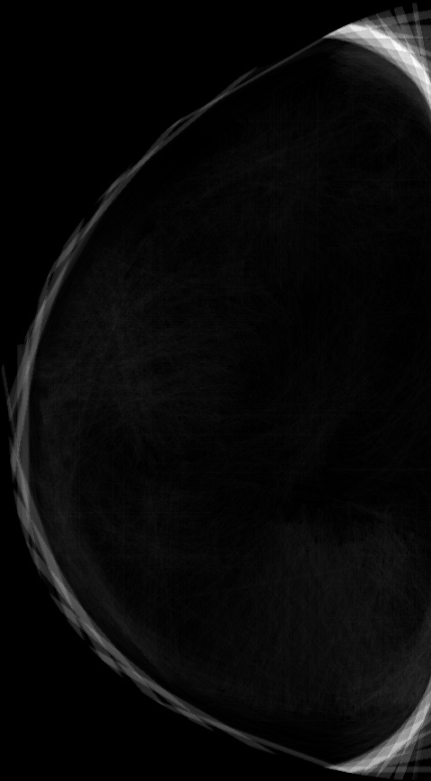
The image output from MMS
Scale 2
Scale 3
Scale 4
Scale 5
Scale 9
…
…
Pre-processed
Mean Shift Filter
…
…
MMS + MSF

Slide 3
The image output from MMS
Scale 2
Scale 3
Scale 4
Scale 5
Scale 9
…
…
Mean Shift Filter
Original
Pre-processed
…
…

Slide 4
K-Means
Scale 2
Scale 3
Scale 4
Scale 5
Scale 9
…
…
Post-Processing
…
…

Slide 5
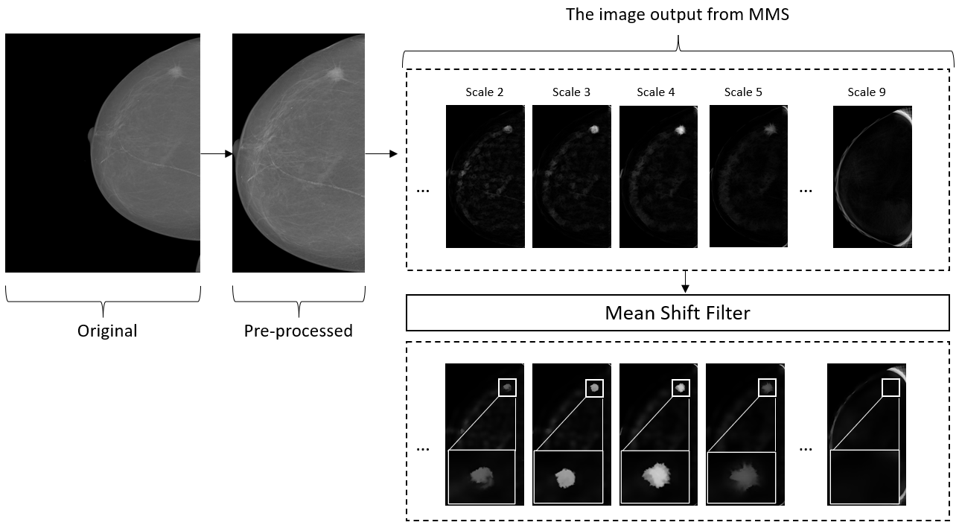
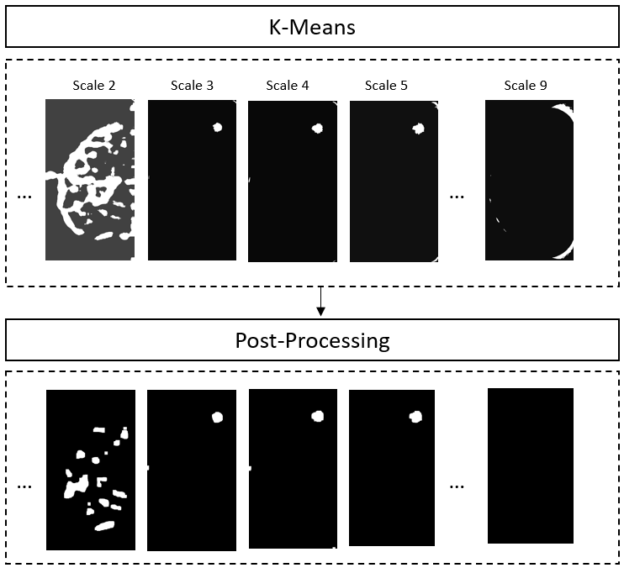

Slide 6
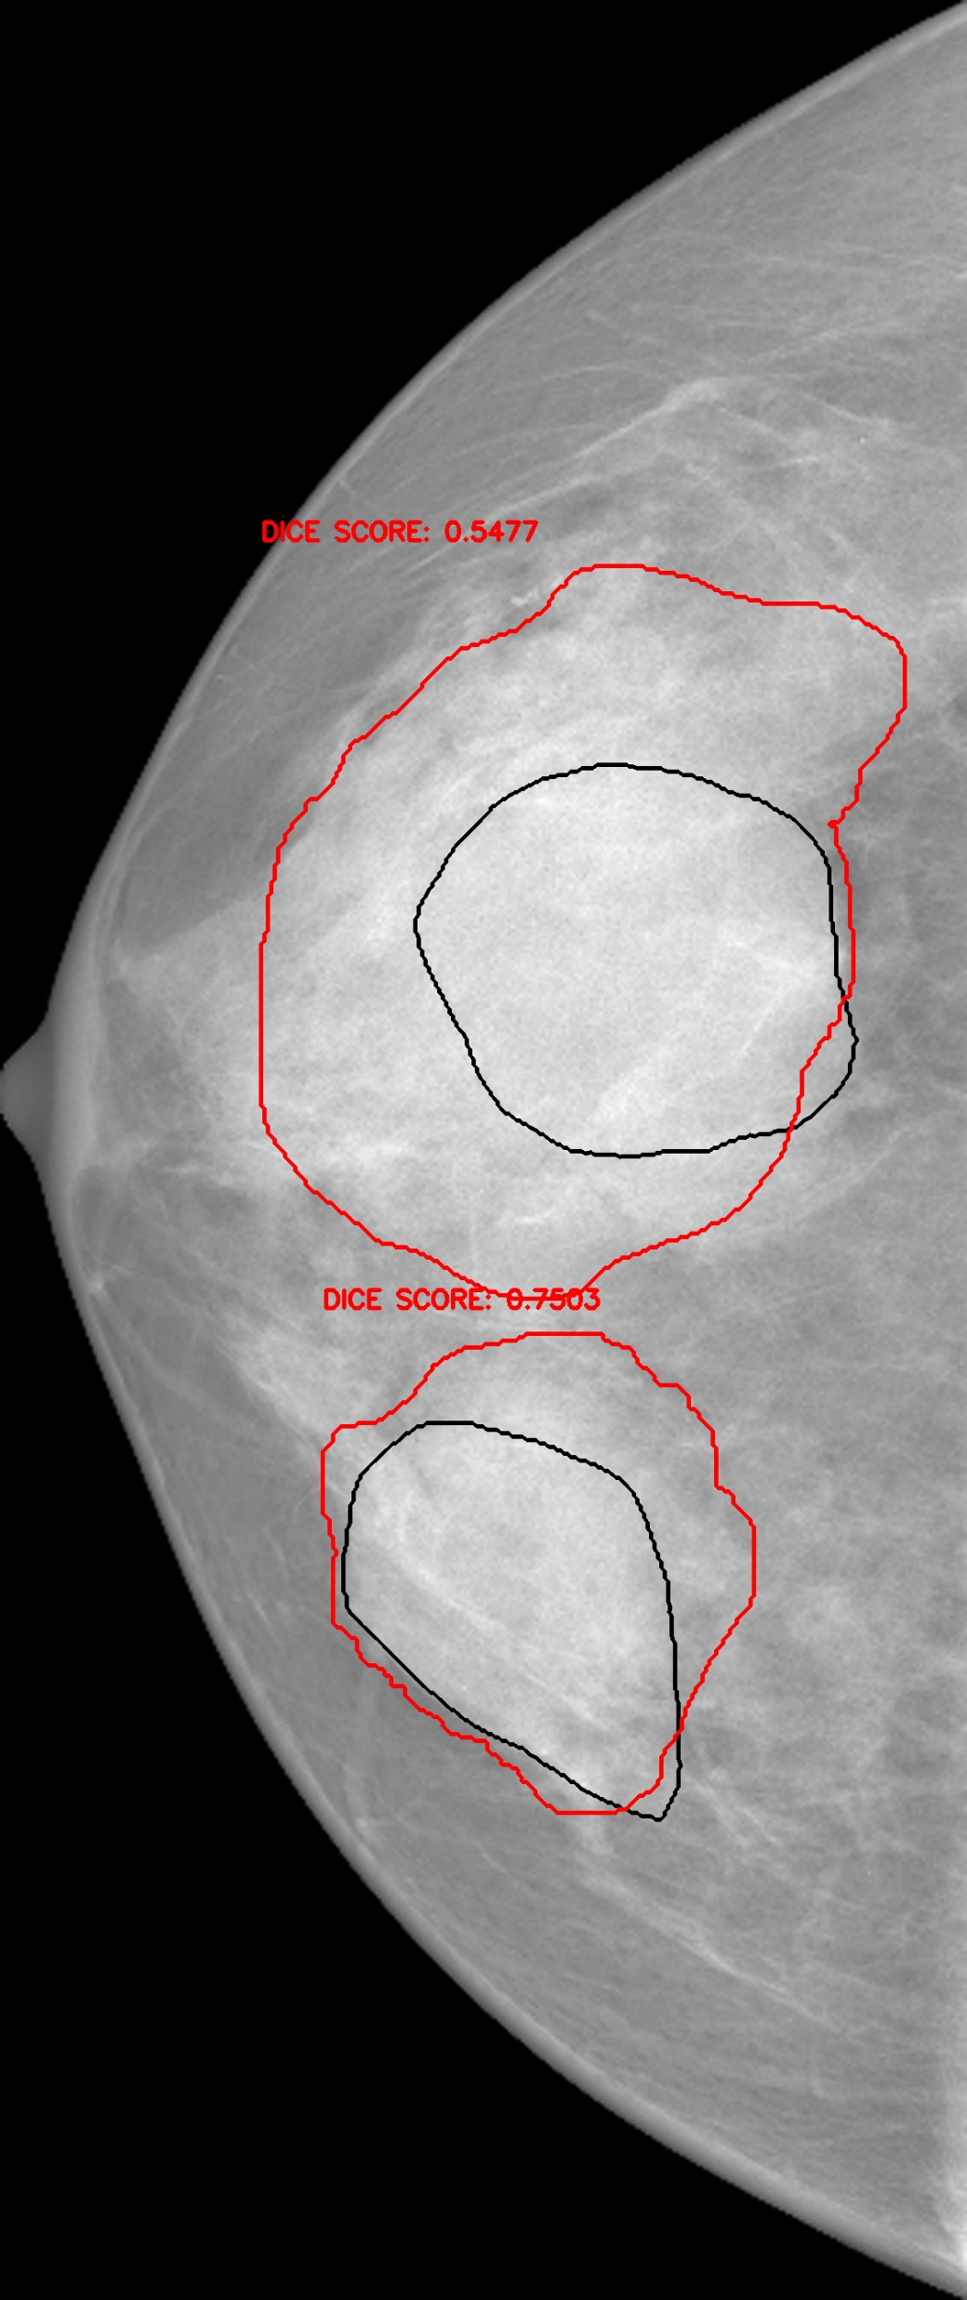
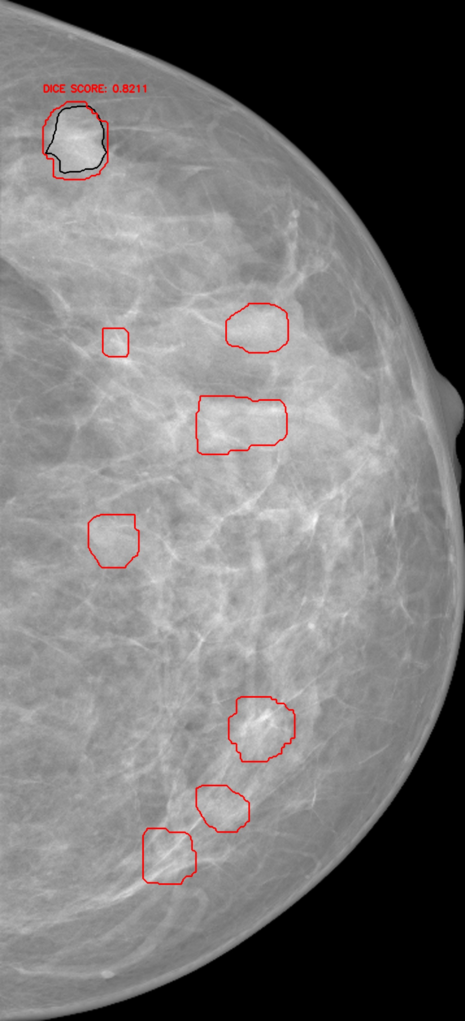
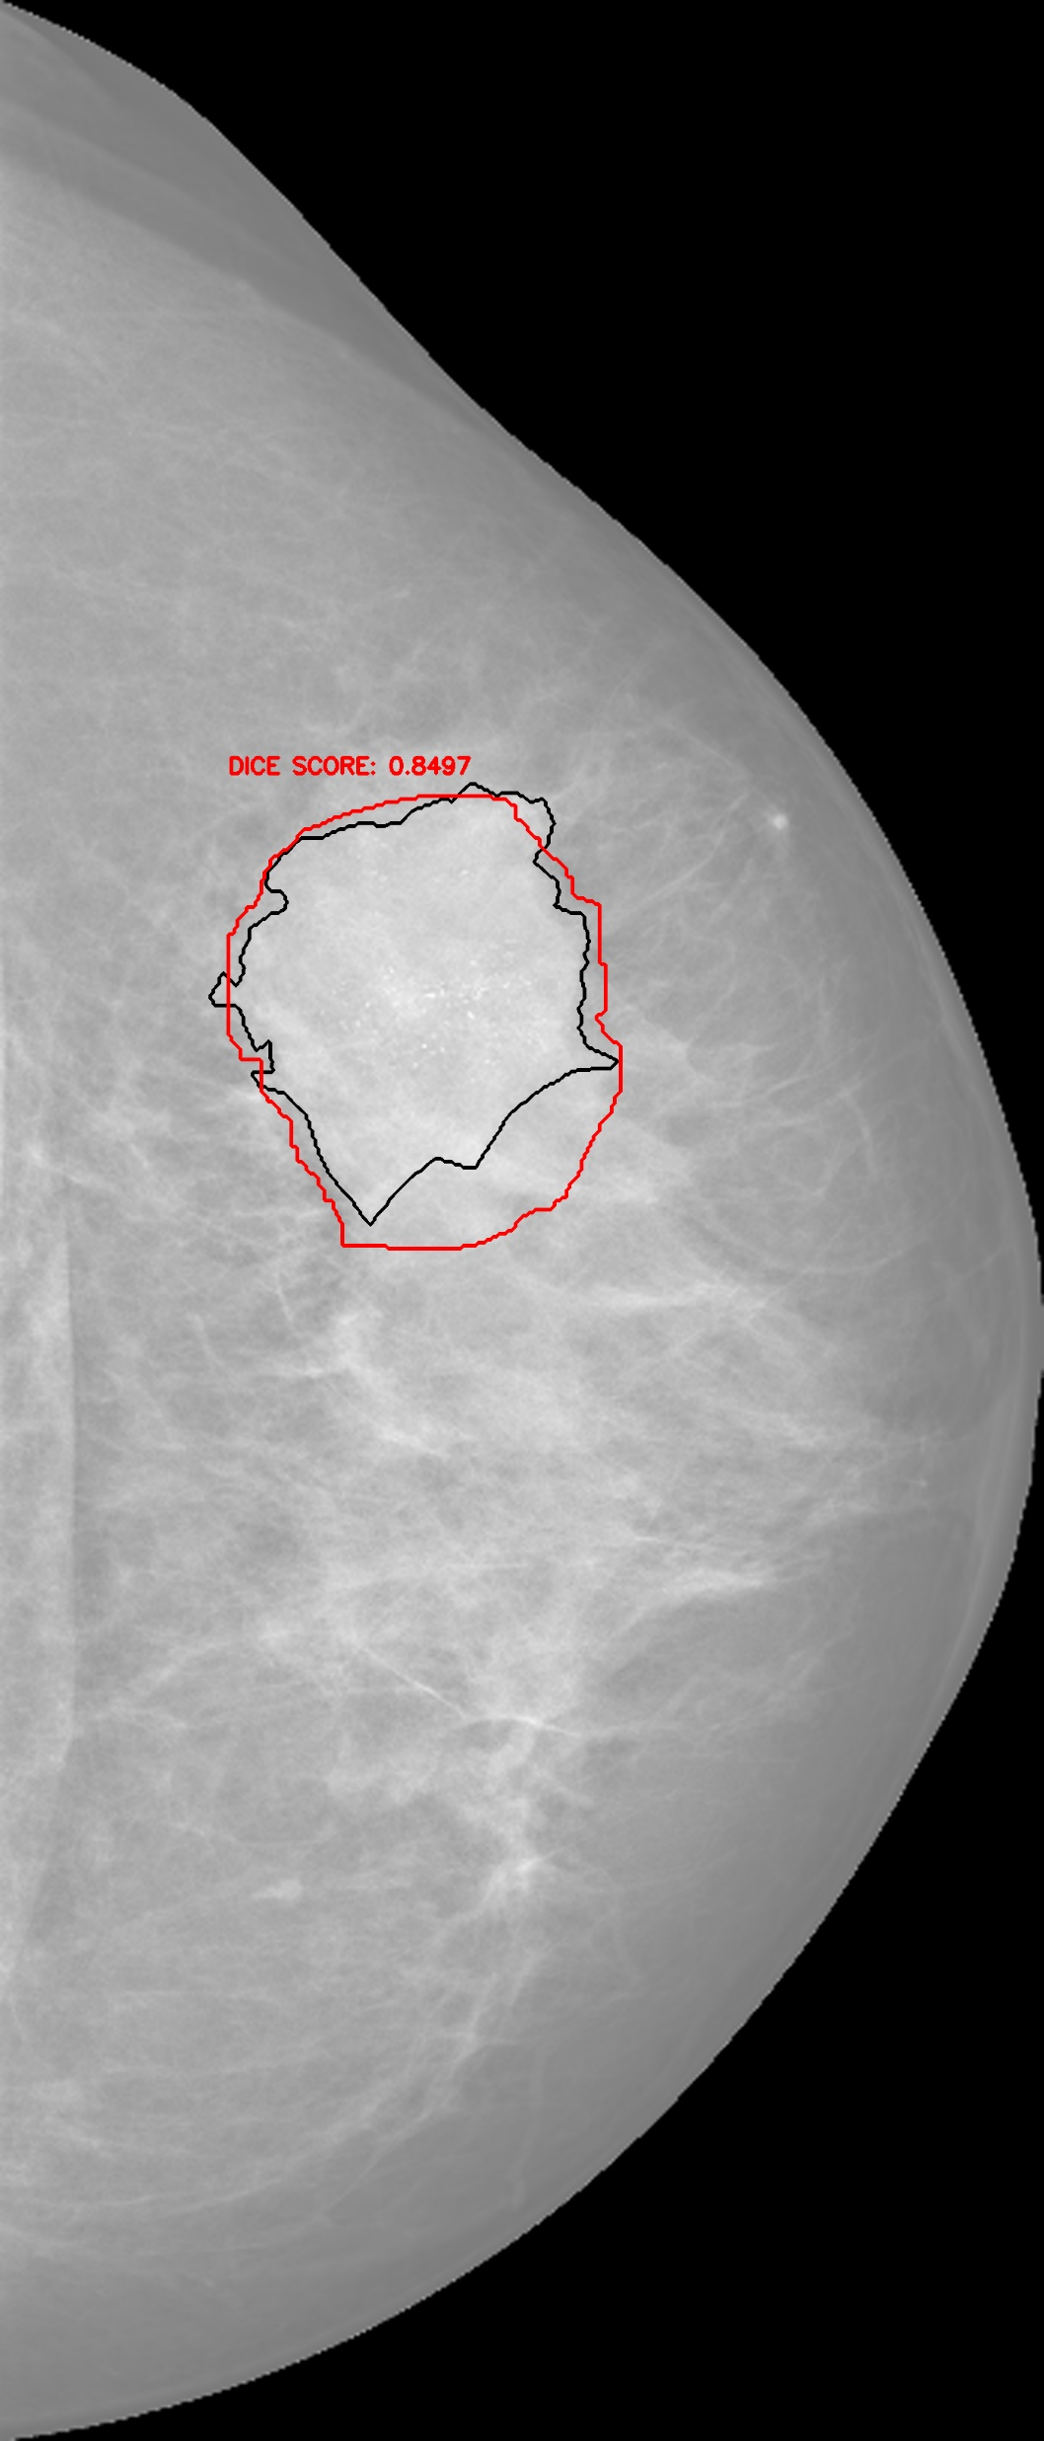
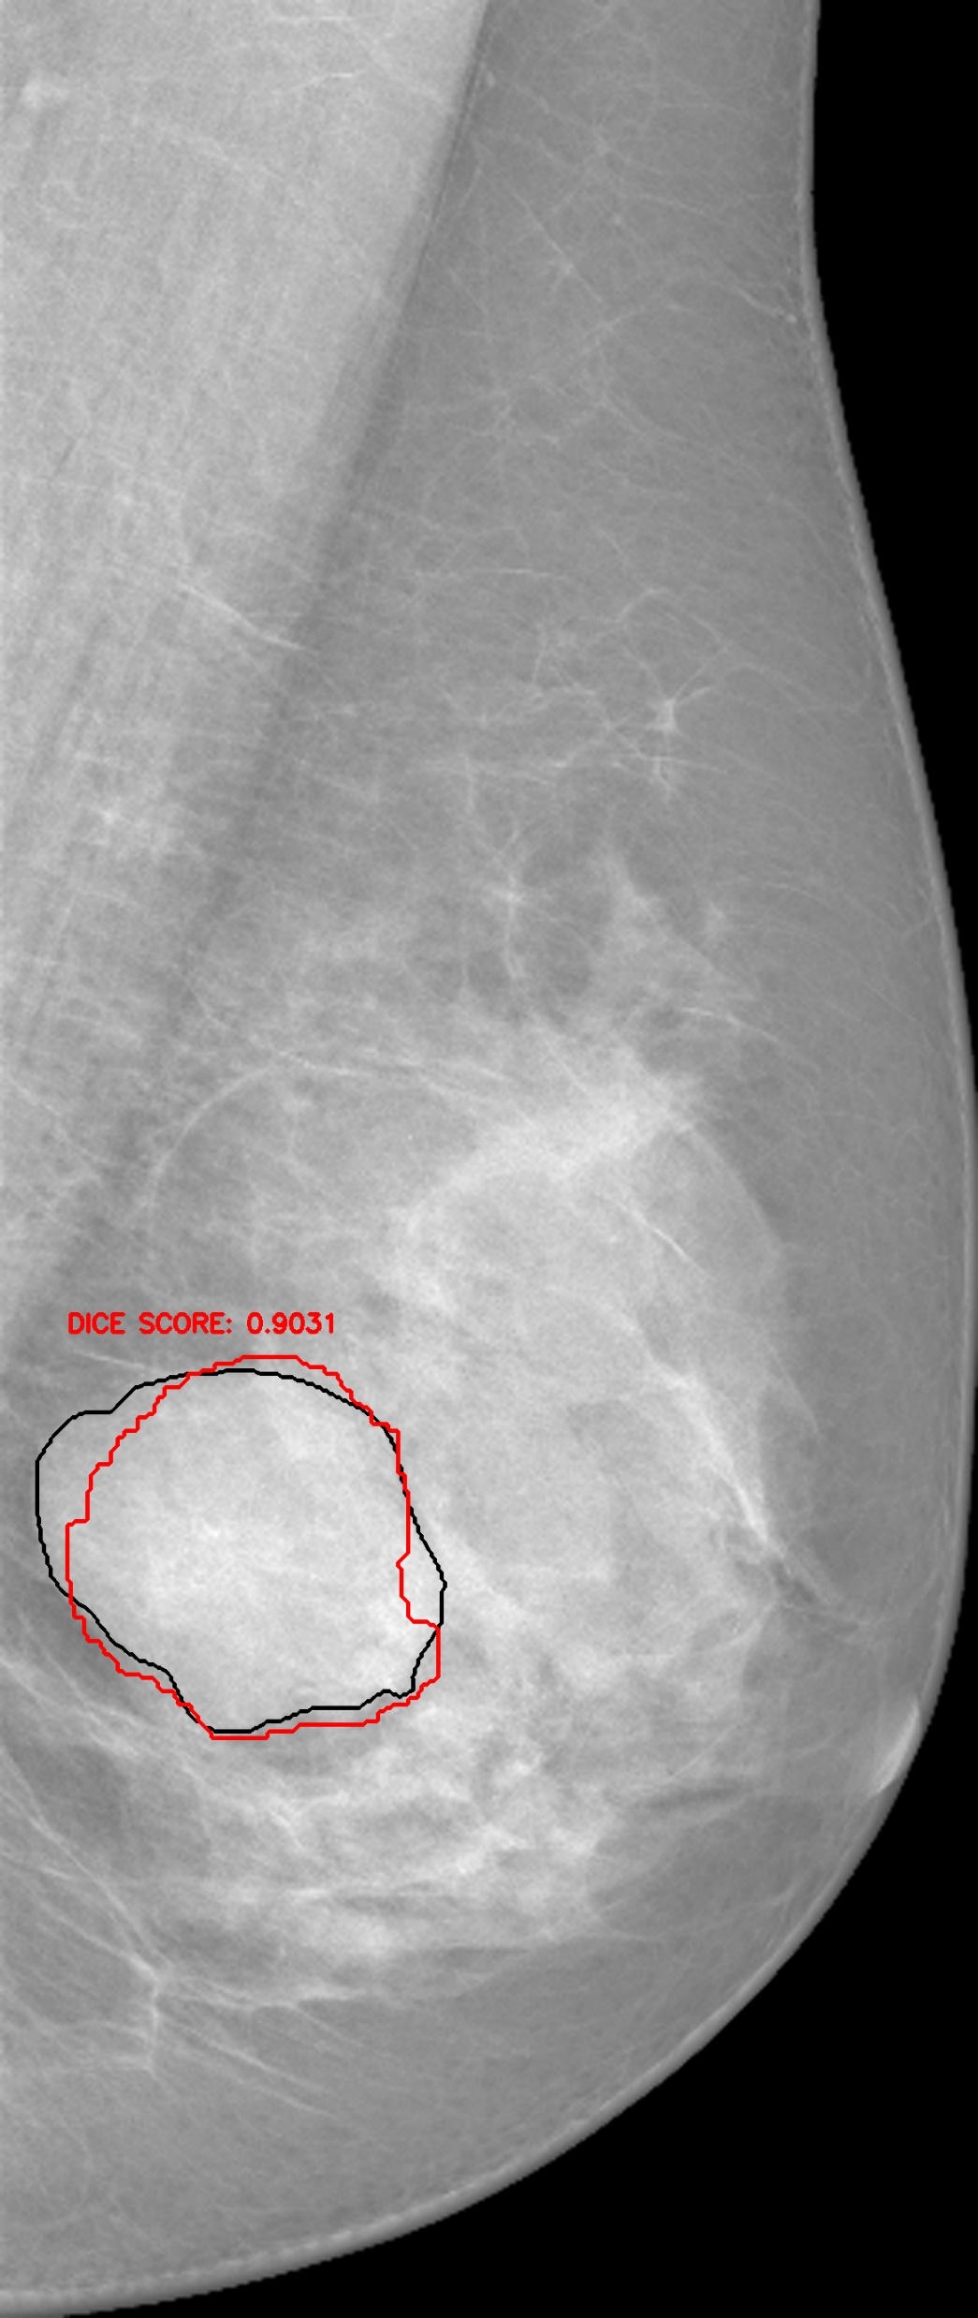
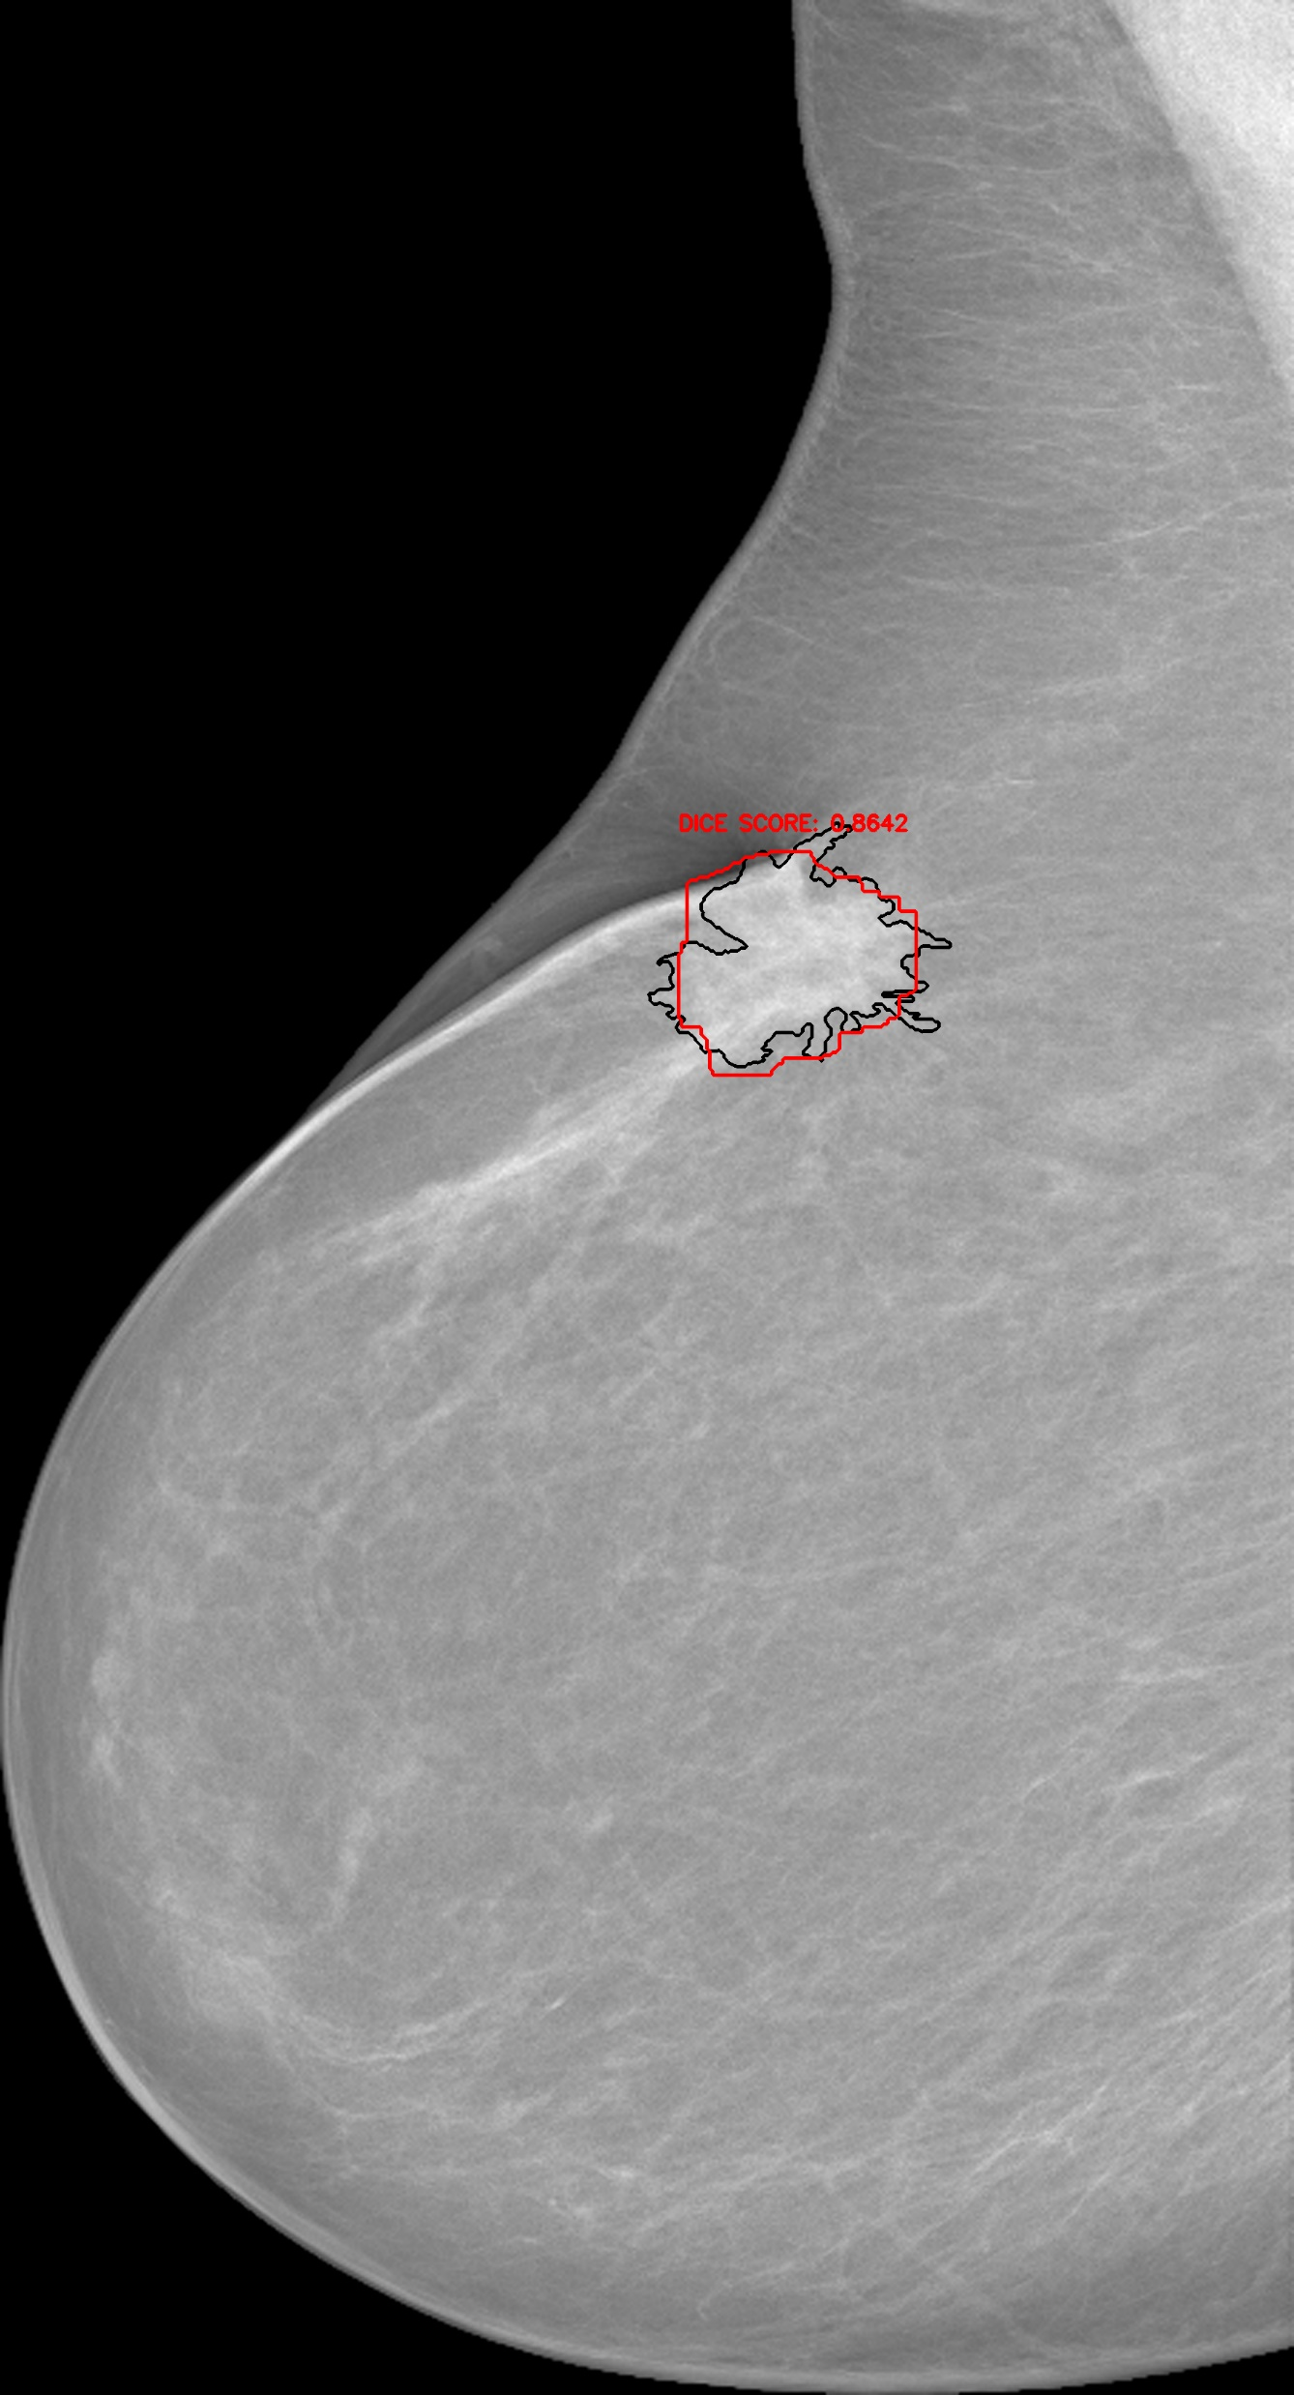
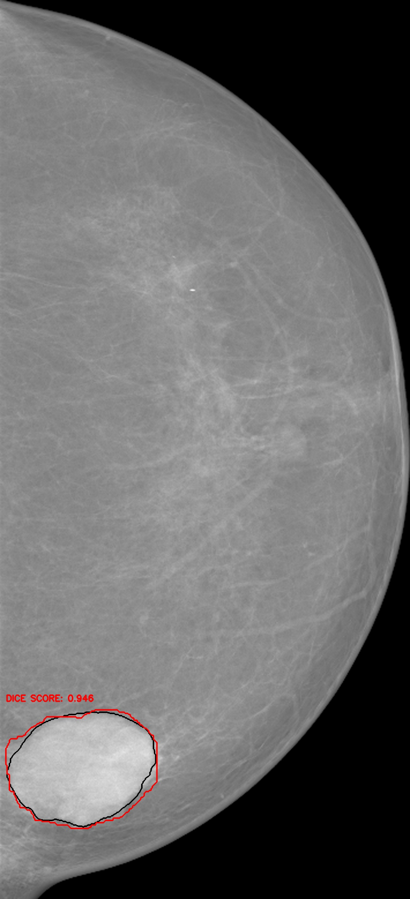
(b)
(d)
(f)
(a)
(c)
(e)
(g)

